Slide 1
The Society of Thoracic Surgeons
General Thoracic Surgery Database Audit
2026

Slide 2
Purpose of the Audit
To assure that the data collected at facilities are valid, therefore attesting to the integrity of the STS General Thoracic Surgery Database
To examine the accuracy, consistency, and completeness of data
To provide education to the sites
Affords an opportunity to identify variability in data collection so STS can share best practices, improve data definitions, and enhance training manuals and other educational offerings
Audit results drive education for our webinars and content provided at AQO

Slide 3
Site Selection for Audit
10% of participating sites are selected for audit
29 GTSD sites selected in 2026
Primary Data and File Contact and Surgeon Representative receive the audit notification via email from STS
  These two contacts will also receive the results at the end of the audit season
Participating sites are removed from the audit selection pool for 3 years after completing an audit that meets expectations according to the STS National Database Audit Policy
  STS reserves the right to utilize various methodologies, including random and targeted selection.
  Targeted or focused audits may be scheduled if requested by a participant or deemed appropriate by STS.

Slide 4
Who Will Perform the Audit?
Healthcare Management Solutions, LLC (HMS) will perform an independent, external audit of the STS General Thoracic Surgery Database
HMS is HIPAA compliant and will conduct audits adhering to strict security policies in accordance with our Business Associate Agreement (BAA) and Sub- Business Agreement with STS
HMS is covered as an affiliate under the BAA you entered into with STS as part of your participation in the Database, so a separate BAA is not needed
All data files received are stored on an encrypted secure server at HMS

Slide 5
General Thoracic Audit
Fill out the STS GTSD Data Collection Questionnaire
Healthcare Management Solutions, LLC (HMS) will perform the audit on a total of 20 lung cancer cases or esophageal cancer cases performed between January 1, 2025 – December 31, 2025, submitted using Version 5.21
HMS will review the site’s OR-generated case log against the cases submitted to IQVIA.
  The OR Log review will be on lung cancer cases or esophageal cancer cases only

Slide 6
STS National Database Audit Policy
A final Summary Report will be emailed by STS to each site. The rate of agreement and data completeness will be considered when evaluating each site and identifying sites that do not meet the STS expectations.
Your report will show variable accuracy, section accuracy, and overall accuracy.
Variable accuracy (agreement) will be measured for each audited variable. The denominator will equal the total number of records audited. The numerator will show the number of records where that variable was a mismatch. This will be reported back as a percentage to sites.

Slide 7
STS National Database Audit Policy
Section accuracy (agreement) will be measured for each section (i.e., demographics, risk factors, complications, discharge, mortality, etc.).
Overall site accuracy (agreement) will be measured for each site as an overall agreement rate. The denominator will equal the total number of records audited. The numerator will show the number of records where that variable was a mismatch. This will be reported back as a percentage to sites.

Slide 8
STS National Database Audit Policy
For Overall Variables:
98.0% or greater is defined as a site that exceeds expectations
90.0% to 97.9% is defined as a site that meets expectations
A site achieving less than 89.9% is defined as a site that does not meet expectations and will require a re-audit within two years

Slide 9
Audit Policy – Overall Variables
Sequence Number | Long Name | Short Name
10 | Operations Table Record Identifier | RecordID
90 | Operation Table Patient Identifier | PatID
270 | Race - Multi-Select | RaceMulti
360 | Admission Date | AdmitDt
370 | Primary Payor | PayorPrim
420 | Secondary (Supplemental) Payor | PayorSecond
500 | Hospital Name | HospName
540 | Height In Centimeters | HeightCm
550 | Weight In Kilograms | WeightKg
580 | Prior Surgical History in Planned Operative Field | Reop
590 | History of Cardiopulmonary Disease - Hypertension | HistCarPulDis (Hypertn) Harvest code = 2
590 | History of Cardiopulmonary Disease - Coronary Artery Disease | HistCarPulDis (CAD) Harvest code = 3
590 | History of Cardiopulmonary Disease - Congestive Heart Failure | HistCarPulDis (CHF) Harvest code = 6
590 | History of Cardiopulmonary Disease - Interstitial Fibrosis/Interstitial Lung Disease | HistCarPulDis (Interstitial Lung Disease) Harvest code = 12

Slide 10
Audit Policy – Overall Variables
610 | History of Vascular Disease - Major Aortic or Peripheral Vascular Disease | HistVasDis (MVD) Harvest code = 2
610 | History of Vascular Disease - Transient Ischemic Attack | HistVasDis (TIA) Harvest code = 4
610 | History of Vascular Disease - Cerebrovascular Accident | HistVasDis (CVA) Harvest code = 5
630 | History of Endocrine GI Renal Disease - Liver Dysfunction | HistEndoGiRenDis (Dialysis) Harvest code = 4
650 | History of Cancer - Preoperative Chemotherapy/Immunotherapy | HistCancer (PreopChemoCur) Harvest code = 3
650 | History of Cancer - Preoperative Thoracic Radiation Therapy | HistCancer (PreopXRT) Harvest code = 4
675 | Preoperative Chemo - Current Malignancy - Multi-Select | PreopChemoCurWhenMulti
685 | Preoperative Thoracic Radiation Therapy - Disease and When Treated - Multi-Select | PreopXRTDisWhenMulti
690 | Preoperative Medication History - Chronic Immunosuppressive Therapy | HisPreopMeds (PreopImmunoThx) Harvest code = 2

Slide 11
Audit Policy – Overall Variables
710 | Last Creatinine Level | CreatLst
740 | Pulmonary Function Tests Performed | PFT
750 | FEV1 Predicted | FEVPred
781 | DLCO Lowest Predicted | DLCOPredLow
800 | Cigarette Smoking History | CigSmoking
870 | ECOG Score | ECOGScore
1250 | Category of Disease - Primary | CategoryPrim
1310 | Date of Surgery | SurgDt
1360 | Procedure Start Time | ProcStartT
1370 | Procedure End Time | ProcEndT
1390 | Status of Operation | Status
1410 | Unanticipated Surgical Approach Conversion | UnanticConv
1460 | ASA Classification | ASA
NA | NA | PrimaryProcedure
1510 | Primary Lung Cancer Resection Performed | LungCancer
1530 | Esophageal Cancer Resection Performed | EsophCancer

Slide 12
Audit Policy – Overall Variables
1620 | Clinical Staging Methods - PET/CT | ClinStagMeth (PET/CT) Harvest code = 1
1800 | Clinical Staging Lung Cancer Tumor Size In cm | LungCaTumSz
1810 | Lung Cancer T Stage | ClinStageLungTumor
1820 | Lung Cancer Nodes - N | ClinStageLungN
1830 | Lung Cancer Metastasis - M | ClinStageLungM
1850 | Pathological Staging - Lung Cancer - T | PathStageLungT
2020 | Number of Malignant Nodes | NumMaligNodes
2030 | Lung Cancer - Number of Nodes | LungCANodes
2040 | Pathological Staging - Lung Cancer - N | PathStageLungN
2060 | Lung CA Metastases | PathStageLungM
2100 | Lung Cancer - Pathology Margins | LungCAPathMarg
2135 | Clinical Staging Performed For Esophageal Cancer - Multi-Select - EUS | ClinStageEsophMulti (EUS) Harvest Code = 5
2220 | Esophageal Cancer Tumor - T | ClinStageEsophT
2230 | Clinical Diagnosis of Nodal Involvement | ClinStageEsophNode
2240 | Esophageal Cancer Metastasis - M | ClinStageEsophM

Slide 13
Audit Policy – Overall Variables
2410 | Pathological Staging - Esophageal Cancer - T | PathStageEsophT
2420 | Pathological Staging - Esophageal Cancer - N | PathStageEsophN
2430 | Pathological Staging - Esophageal Cancer - M | PathStageEsophM
2440 | Pathological Staging - Esophageal Cancer - H | PathStageEsophH
2460 | Esophageal Cancer - Number of Nodes | EsophCANodes
2470 | Esophageal Cancer - Pathology Margins | EsophCAPathMarg
3660 | Postoperative Events Occurred | POEvents
3670 | Post Op Procedure Through New or Existing Incision | PostOpProc
3720 | Pneumonia | Pneumonia
3740 | Acute Respiratory Distress Syndrome | ARDS
3760 | Respiratory Failure | RespFail

Slide 14
Audit Policy – Overall Variables
3770 | Bronchopleural Fistula | Bronchopleural
3780 | Pulmonary Embolus | PE
3810 | Initial Vent Support >48 Hours | Vent
3820 | Tracheostomy | Trach
3830 | Atrial Arrhythmia Requiring Treatment | AtrialArryth
3870 | Myocardial Infarct | MI
3910 | Delayed conduit emptying requiring intervention | DelayCondEmp
3920 | Esophagogastric leak from anastomosis following esophageal surgery | PostopProcAL
4080 | Recurrent laryngeal nerve paresis - new onset | LaryngealNerve
4210 | Hospital Discharge Date | DischDt
4220 | Hospital Discharge Status | MtDCStat
4230 | Discharge Location | DisLoctn
4235 | Discharged with Chest Tube | CTubeDis
4270 | Readmission within 30 days of Discharge | Readm30Dis
4290 | Substance Use Screening and Counseling | DCSubUseScre
4310 | Status 30 Days After Surgery | Mt30Stat

Slide 15
STS National Database Audit Policy
For the Post Operative Events (Appendix B) and Mortality (Appendix C) sections:
98.0% or greater is defined as a site that meets expectations
90% to 97.9% is defined as a site that does not meet expectations and requires further education
A site achieving 89.9% or less on the Post Operative Events or Mortality section will require a re-audit within two years

Slide 16
Audit Policy – Post Operative Events Section Variables
Long Name | Short Name | Sequence Number
Postoperative Events Occurred | POEvents | 3660
Post Op Procedure Through New or Existing Incision | PostOpProc | 3670
Pneumonia | Pneumonia | 3720
Acute Respiratory Distress Syndrome | ARDS | 3740
Respiratory Failure | RespFail | 3760
Bronchopleural Fistula | Bronchopleural | 3770
Pulmonary Embolus | PE | 3780
Initial Vent Support >48 Hours | Vent | 3810
Tracheostomy | Trach | 3820
Atrial Arrhythmia Requiring Treatment | AtrialArryth | 3830
Myocardial Infarct | MI | 3870
Delayed conduit emptying requiring intervention | DelayCondEmp | 3910
Esophagogastric leak from anastomosis following esophageal surgery | PostopProcAL | 3920
Recurrent laryngeal nerve paresis - new onset | LaryngealNerve | 4080

Slide 17
Audit Policy – Post Operative Events Section Variables
Complications - Mismatch Due to Missing Parent Field or Inaccurate Child Field
Data Element | SeqNo | Cases | MisMatches | Agreement
POEvents | 3660 | 20 | 3 | 85.0%
PostOpProc | 3670 | 20 | 3 | 85.0%
Pneumonia | 3720 | 20 | 3 | 85.0%
ARDS | 3740 | 20 | 3 | 85.0%
RespFail | 3760 | 20 | 3 | 85.0%
Bronchopleural | 3770 | 20 | 3 | 85.0%
PE | 3780 | 20 | 3 | 85.0%
Vent | 3810 | 20 | 3 | 85.0%
Trach | 3820 | 20 | 3 | 85.0%
AtrialArryth | 3830 | 20 | 3 | 85.0%
MI | 3870 | 20 | 3 | 85.0%
PostopProcAL | 3920 | 20 | 3 | 85.0%
DelayCondEmp | 3910 | 20 | 3 | 85.0%
LaryngealNerve | 4080 | 20 | 3 | 85.0%
Total |  | 260 | 39 | 85.0%
Complications - Mismatch Due to Inaccurate Child Field
Data Element | SeqNo | # of Random Cases | # of MisMatches | Agreement Percentage
POEvents | 3660 | 20 | 0 | 100.0%
PostOpProc | 3670 | 20 | 0 | 100.0%
Pneumonia | 3720 | 20 | 1 | 95.0%
ARDS | 3740 | 20 | 0 | 100.0%
RespFail | 3760 | 20 | 0 | 100.0%
Bronchopleural | 3770 | 20 | 0 | 100.0%
PE | 3780 | 20 | 1 | 95.0%
Vent | 3810 | 20 | 0 | 100.0%
Trach | 3820 | 20 | 0 | 100.0%
AtrialArryth | 3830 | 20 | 0 | 100.0%
MI | 3870 | 20 | 0 | 100.0%
PostopProcAL | 3920 | 20 | 0 | 100.0%
DelayCondEmp | 3910 | 20 | 0 | 100.0%
LaryngealNerve | 4080 | 20 | 1 | 95.0%
Total |  | 260 | 3 | 98.8%

Slide 18
Audit Policy – Mortality Section Variables
Long Name | Short Name | Sequence Number
Hospital Discharge Status | MtDCStat | 4220
Status 30 Days After Surgery | Mt30Stat | 4310

Slide 19
STS National Database Audit Policy
Verification of post-procedure status for 30-day mortality is required to be submitted to the audit company. This includes any tracking logs, electronic health records, or other documentation to support coding of those variables listed in Appendix D.
100.0% accuracy is defined as meeting expectations
99.9% or less for accuracy is defined as not meeting expectations and will require re-audit within two years

Slide 20
Audit Policy – Verification of Post-Procedure Status
Long Name | Short Name | Sequence Number
Status 30 Days After Surgery | Mt30Stat | 4310

Slide 21
STS National Database Audit Policy
If your site meets expectations for the post operative events section, mortality section, post-procedure verification and overall data variables then your site will receive an audit completion certificate and the site will be removed from the audit pool for the next 3 years
If your site does not meet expectations and requires re-audit within 2 years, your site will be selected for audit in 2 years and STS will provide further information at that time
If you have any questions, please contact Emily Conrad at econrad@sts.org

Slide 22
First Steps
A link to the STS GTSD Data Collection Questionnaire is in the audit notification letter that was sent to the Primary Data and File Contact and Surgeon Representative for your site.
Fill out this questionnaire and provide the lead contact for the audit
HMS staff will take over from there…

Slide 23
Audit Process and Timeline
Audit Request Email- within 10 days of STS GTSD Data Questionnaire Response
Documentation Due Date- 30 business days from Audit Request Email
  **Extensions will be limited to extreme circumstances
Review Period- 2-3 months from documentation submission
Interim Mismatch Report Issued- upon review period completion
Interim Mismatch Report Response- response due 5 business days after site receives Interim Mismatch Report
Adjudication- upon receipt of Interim Mismatch Report response
Final Reporting- sent by STS to Site Administrator and Physician Representative

Slide 24
Audit Request Email
Within 10 business days of your submission of the STS GTSD Data Collection Questionnaire, the contact(s) provided will receive a request email from the STS Mailbox (STS@hcmsllc.com).
This Audit Request Email will contain information about the audit and any deadlines.
  The email will include a link to download:
    The case sample for your site
    The list of variables to be audited
    Document Submission Process Instructions

Slide 25
Documentation Collection
Documentation should be submitted in PDF format.
One PDF file for each case.
Bookmarks or other electronic flags must be used to identify each section of the record.
Use the file naming conventions provided (PDF File Name for Submission column).
All cases can be zipped into one zip file for submission.
Additional information will be provided in your Document Submission Process instructions.

Slide 26
Documents Requested
A list of audited variables will be provided.
Submitted documentation should correspond with the sources you used when entering data into the STS GTSD.
Example source documentation is included with the audited variables list.

Slide 27
OR Log Template
A standardized template will be provided to submit all STS-reportable lung cancer and esophageal cancer procedures performed between January 1, 2025, and December 31, 2025.
Submit the completed template in Excel format; do not PDF.
Only the provided template should be used; alternate formats will not be accepted.

Slide 28
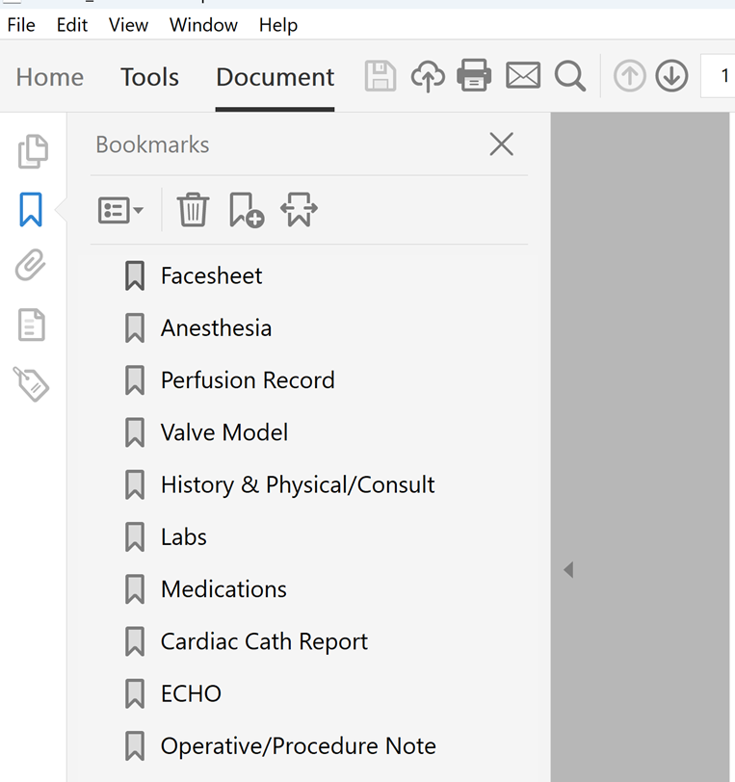
Document Collection: Bookmarking

Slide 29
Documentation Collection:
Bookmarking Demo

Slide 30
Documentation Tips
Submit only documentation relevant to the specific case — do not include the entire patient record.
Screenshots or snips are acceptable as long as they include enough surrounding detail to identify the patient and encounter.
All submitted documentation must include patient identifiers and encounter dates, including screenshots or snips.
Missing or irrelevant documentation may lead to mismatches during the audit.
Submit documentation before the due date to avoid delays from unforeseen submission issues.

Slide 31
Submission of Documentation
Upload documents using the file submission link that will be provided in your Audit Request Email.
Submission is secure and encrypted.
Submissions will not be accepted via email.
If you experience any issues with submission, reach out to the STS Audit Team at STS@hcmsllc.com.

Slide 32
Interim Mismatch Report
Issued following completion of the documentation review (typically 2–3 months).
Provides an opportunity to submit additional documentation or clarify identified discrepancies.
Please return the Excel report with your responses, including comments in the designated final column.
If you choose not to respond, please indicate this in your reply to the original email.

Slide 33
Clinical Lead Tips

Slide 34
Submission Tips
All submissions must be reviewed by your site’s data abstractor to ensure completeness and accuracy. Please include only the documentation that was used during case abstraction for submission to the STS.
Do not submit the entire patient record or full encounter documentation. Only relevant, supporting materials used in abstraction should be included.
Knowing what data was entered into the database will guide you in what records to include in submission to HMS.

Slide 35
Q&A
Feel free to utilize the Q&A function and we will address your questions

Slide 36
Contacting HMS
If you experience any issues with submitting your documentation, please contact the HMS Audit Team at STS@hcmsllc.com.
Be sure to include your 5-digit STS Participant ID (PID) number in all communications

